Slide 1
Coursera Capstone project
Parameswaran Periaswamy
March,2019

Slide 2
Report Content
Introduction Section :
The “business problem” to be solved by this project and who may be interested
Data Section:
Describe Data requirements and Sources needed to solve the problem
Methodology section:
Main component of the report - Execute data processing, describe/discuss any
exploratory data analysis and/or inferential statistical testing performed, and/or
machine learnings used.
Results section:
Discussion of the results and finding of answer
Discussion section:
Discussion of observations noted and any recommendations
Conclusion section:
Answer chosen and conclusions

Slide 3
1. Introduction Section
1.1 Scenario and Background
I am a data scientist residing in Bangalore India. I currently live within walking distance to MG Road metro station and I enjoy many amenities and venues in the area, such as various international cuisine restaurants, cafes, food shops and entertainment. I have been offered a great opportunity to work for a leader firm in Manhattan, NY. I am very excited and I want to use this opportunity to practice my learnings in Coursera in order to answer relevant questions arisen. The key question is : How can I find a convenient and enjoyable place similar to mine now in India? Certainly, I can use available real estate apps and Google but the idea is to use and apply myself the learned tools during the course.

Slide 4
1. Introduction Section
1.2 Problem to be resolved:
Business Problem:
The challenge is to find a suitable apartment for rent in Manhattan NY that complies with the demands on location, price and venues. Therefore, in order to set a basis for comparison, I want to find a rental unit subject to the following conditions:
apartment must be 2 or 3 bedrooms
desired location is near a metro station in the Manhattan area and within 1.0 mile (1.6 km) radius
price of rent not exceed $7,000 per month
top amenities in the selected neighbourhood shall be similar to current residence
desirable to have venues such as coffee shops, restaurants Indian, wine stores, gym and food shops
as a reference, I have included a map of venues near current residence in India.

Slide 5
1. Introduction Section
1.3 Interested Audience
I believe this is a relevant project for a person or entity considering moving to a major city in Europe, US or Asia, since the approach and methodologies used here are applicable in all cases. The use of FourSquare data and mapping techniques combined with data analysis will help resolve the key questions arisen. Lastly, this project is a good practical case toward the development of Data Science skills.

Slide 6
2 Data Section
2.1 Data Requirements
- Geodata for current residence in Bangalore with venues established using Foursquare.
- List of Manhattan (MH) neighbourhoods with clustered venues established via https://en.wikipedia.org/wiki/List_of_Manhattan_neighborhoods#Midtown_neighborhoods
- List of subway metro stations in Manhattan with addresses and geo data (lat,long): https://en.wikipedia.org/wiki/List_of_New_York_City_Subway_stations_in_Manhattan) , (https://www.google.com/maps/search/manhattan+subway+metro+stations/@40.7837297,- 74.1033043,11z/data=!3m1!4b1)
- List of apartments for rent in Manhattan area with information on neighbourhood location, address, number of beds, area size, monthly rent price and complemented with geo data via Nominatim. http:/www.rentmanhattan.com/index.cfm?page=search&state=results https://www.nestpick.com/search?city=new-
- Place to work in Manhattan (Park Avenue and 53rd St) for reference

Slide 7
2 Data Section
2.2 Data Sources, Data Processing and Tools used
- Bangalore data and map is to be created with use of Nominatim , Foursquare and Folium mapping
- Manhattan neighbourhoods were obtained from Wikipedia and organized by Neighbourhoods with geodatavia Nominatim for mapping with Folium.
- List of Subway stations was obtained via Wikipedia, NY Transit web site and Google map,
- List of apartments for rent was consolidated from web-scraping real estate sites for MH.
- The geolocation (lat,long) data was found with algorithm coding and using Nominatim.
- Folium map was the basis of mapping with various features to consolidate all data in ONE map where one can visualize all details needed to make a selection of apartment

Slide 8
3 Methodology
The Strategy to find the answer:
The strategy is based on mapping the described data in section 2.0, in order to facilitate the choice of at least two candidate places for rent. The information will be consolidated in ONE MAP where one can see the details of the apartment, the cluster of venues in the neighbourhood and the relative location from a subway station and from work place. A measurement tool icon will also be provided. The popups on the map items will display rent price, location and cluster of venues applicable.

Slide 9
3 Methodology
The Tools:
Web-scraping of sites is used to consolidate data-frame information which was saved as csv files for convenience and to simply the report. Geodata was obtained by coding a program to use Nominatim to get latitude and longitude of subway stations and also for each of (144 units) the apartments for rent listed. Geopy_distance and Nominatim were used to establish relative distances. Seaborn graphic was used for general statistics on rental data. Maps with popups labels allow quick identification of location, price and feature, thus making the selection very easy

Slide 10
4 Execution and Results

Slide 11
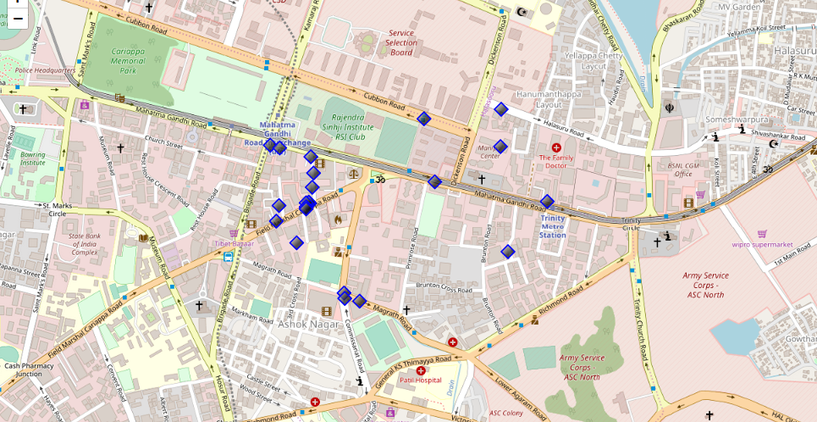
Current residence Neighbourhood in Bangalore

Slide 12
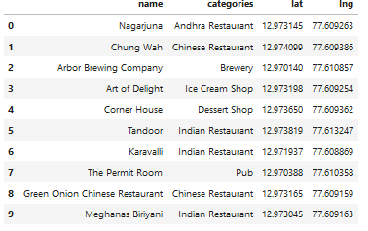
Venues around Neighbourhood

Slide 13
Manhattan Map - Neighborhoods and Cluster of Venues

Slide 14
Geodata Manhattan Apts for rent

Slide 15
Rental Price Statistics MH Apartments
Budget US7000/month is around the mean

Slide 16
Apartments for Rent in MH

Slide 17
MH Apts for rent with venue clusters

Slide 18
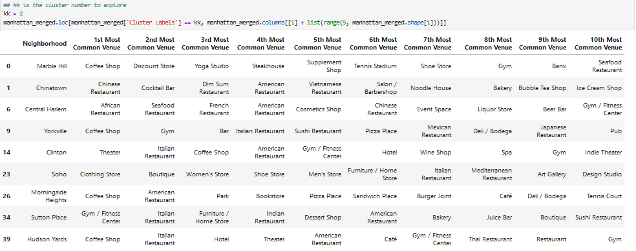
Venues of cluster 2

Slide 19
Manhattan subway stations geodata

Slide 20
Apts for rent (blue) and subway stations (red)

Slide 21
Selected Apartment!

Slide 22
5 DISCUSSION
Apartment Selection
Apartment 1 rent cost is US7500 slightly above the US7000 budget. Apt 1 is located 400 meters from subway station at 59th Street and work place ( Park Ave and 53rd) is another 600 meters way. I can walk to work place and use subway for other places around. Venues for this apt are as of Cluster 2 and it is located in a fine district in the East side of Manhattan.
Apartment 2 rent cost is US6935, just under the US7000 budget. Apt 2 is located 60 meters from subway station at Fulton Street, but I will have to ride the subway daily to work , possibly 40-60 min ride. Venues for this apt are as of Cluster 3.

Slide 23
6 CONCLUSIONS
Based on current Bangalore venues, I feel that Cluster 2 type of venues is a closer resemblance to my current place. And is within walkable distance.
That means that APARTMENT 1 is a better choice since the extra monthly rent is worth the conveniences it provides.

